Slide 1
Digital Portfolio
STUDENT NAME: MONICA C
REGISTER NO AND NMID: 212403828/asunm1453212403828
DEPARTMENT: BCA
COLLEGE: VEL TECH RANGA SANKU ARTS COLLEGE/MADRAS UNIVERSITY

Slide 2
PROJECT TITLE
Digital Portfolio Website

Slide 3


AGENDA
Problem Statement
Project Overview
End Users
Tools and Technologies
Portfolio design and Layout
Features and Functionality
Results and Screenshots
Conclusion
Github Link
3/21/2024 Annual Review

Slide 4

PROBLEM STATEMENT
In today's competitive world, students need a platform to showcase their skills, projects, and achievements.
Traditional resumes are limited in presenting real-time updates and interactive content.
Lack of a centralized platform reduces visibility for students in placements and higher studies.

Slide 5

PROJECT OVERVIEW
A personal digital portfolio website designed to highlight academic achievements, technical skills, and project works.
Provides an interactive and professional platform for students to share their profiles with recruiters and peers.
Ensures easy access to resumes, certificates, and project links anytime, anywhere.

Slide 6

WHO ARE THE END USERS?
Students: To showcase their portfolio.
Recruiters/Companies: To evaluate candidates efficiently.
Educational Institutions: For maintaining student records.

Slide 7

TOOLS AND TECHNIQUES
Frontend: HTML, CSS, JavaScript, React.js
Backend: Node.js / Express.js
Database: MongoDB / MySQL
Version Control: Git & GitHub
Hosting: Netlify / Vercel / GitHub Pages

Slide 8
POTFOLIO DESIGN AND LAYOUT
Homepage: Introduction, photo, contact links
About Section: Academic & personal background
Skills Section: Technical & soft skills
Projects Section: Previous works with links
Contact Section: Email, phone, social media
Clean UI/UX with responsive design

Slide 9
FEATURES AND FUNCTIONALITY
User-friendly, interactive, and responsive design
Easy navigation with categorized sections
Dynamic project showcase with links to GitHub
Secure and fast deployment
Accessible on multiple devices

Slide 10
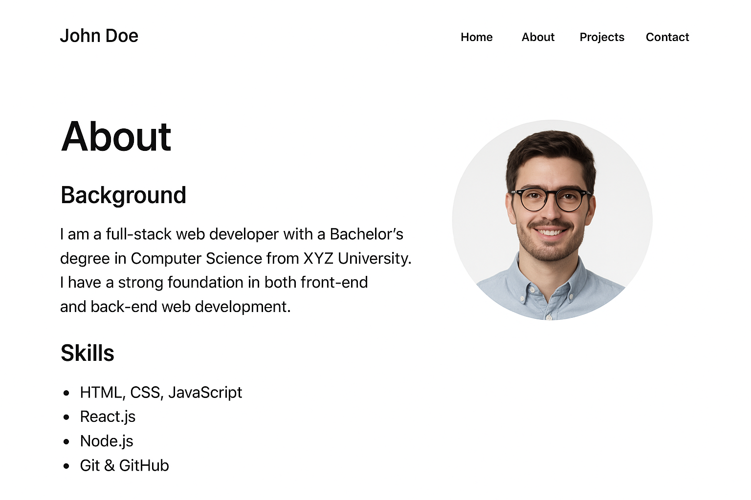

RESULTS AND SCREENSHOTS
Successfully hosted on GitHub Pages.
Accessible to recruiters via sharable link
Provides professional representation of student profile
3/21/2024 Annual Review

Slide 11
CONCLUSION
Digital Portfolio provides an innovative way for students to showcase their achievements.
Enhances placement opportunities by giving recruiters easy access to profiles.
A modern alternative to traditional resumes.

Slide 12
Github Link
https://github.com/monicasekar098-cmd/Digital-Portfolio-Website

